Slide 1
Obtaining the Bi₂Te₃ thermoelectric thin films by using pulsed laser deposition
Shupenev Alexander
MT12-47
2013

Slide 2
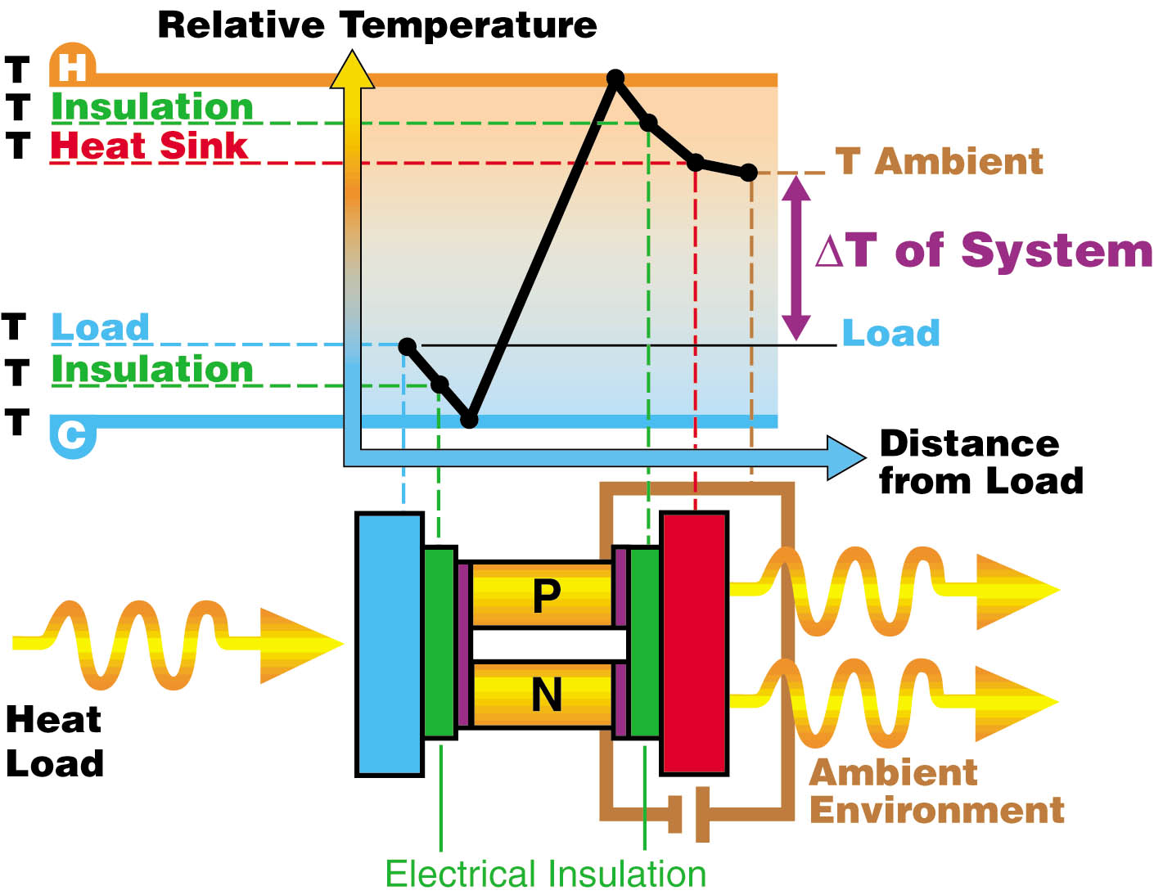
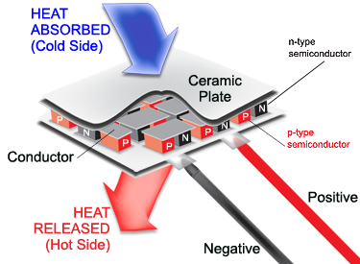
The Peltier device principles

Slide 3
Features and advantages
Features
Generating electricity
Temperature measurements
Advantages
No moving parts
Noiselessness
Temperature controlling
Cooling and heating
High automation
No gas or liquids
Efficiency
5-10% (50% conventional)

Slide 4
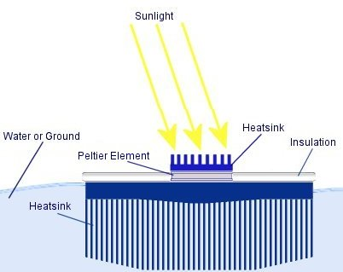
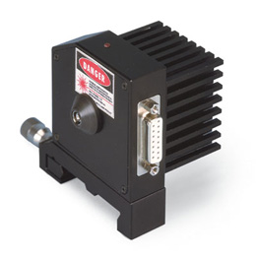
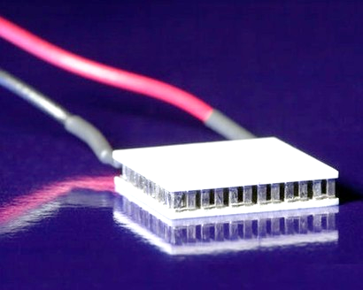
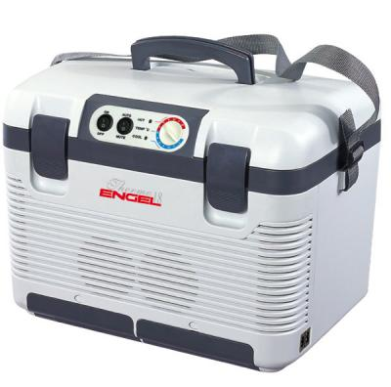
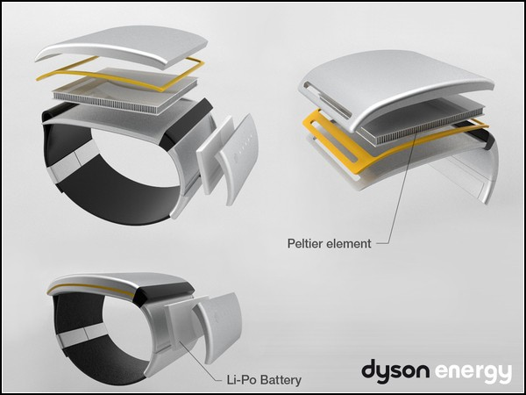
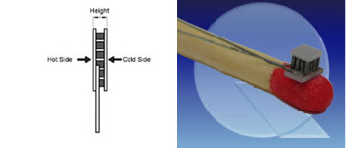
Applications
Temperature controlling +\- 0.01 C
Electric generators
Cooling And Heating

Slide 5
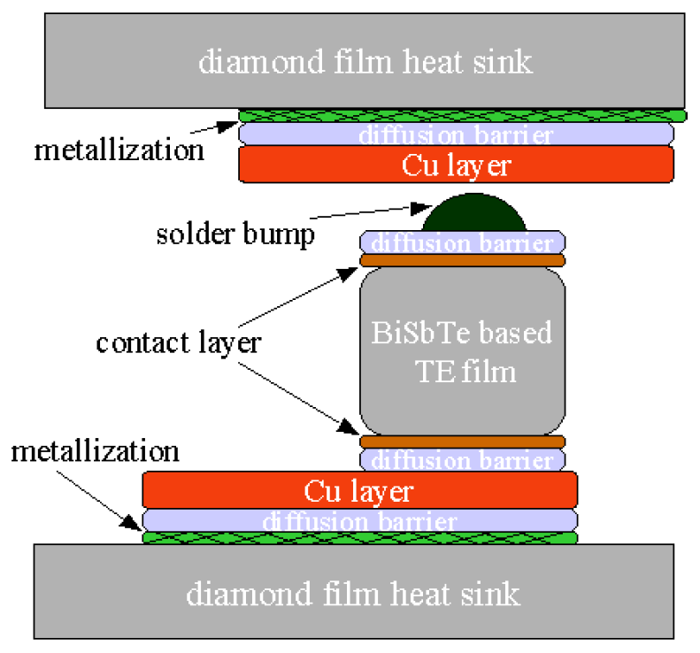
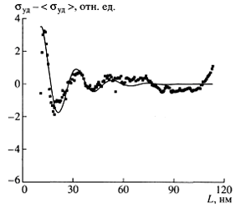
The hypothesis
Quantum effects
thermoelectric figure of merit
Thermoelectric device structure

Slide 6
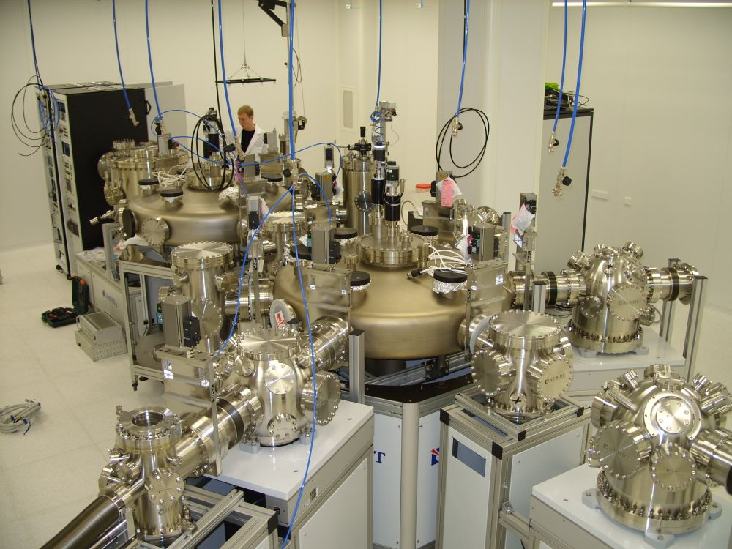
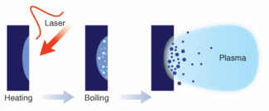
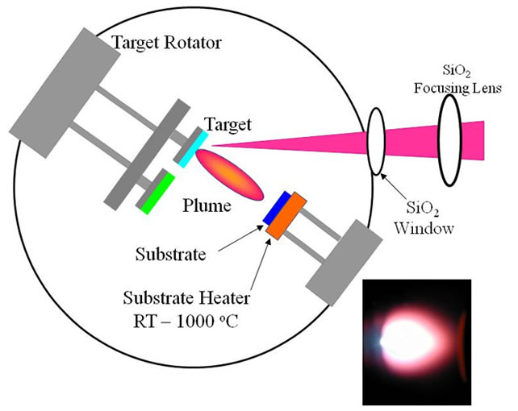
The PLD technology
The equipment: Nanofab-100
PLD – Pulsed Laser Deposition

Slide 7
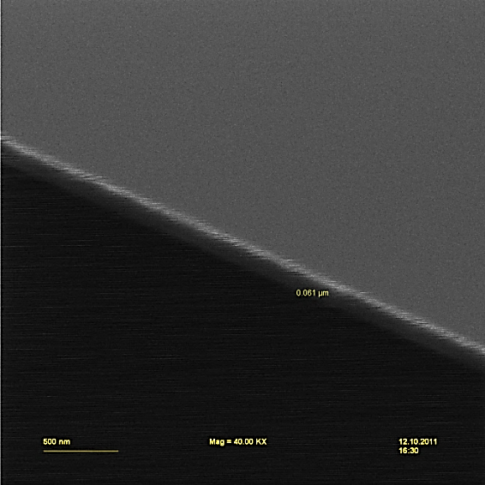
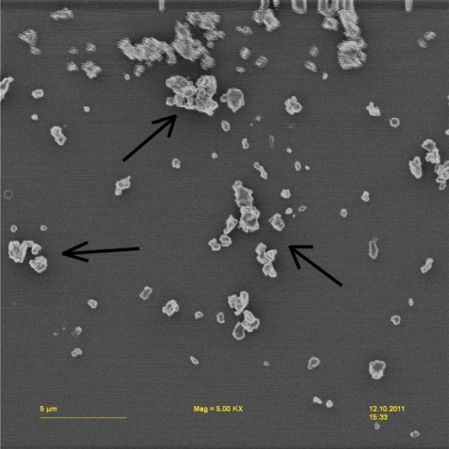
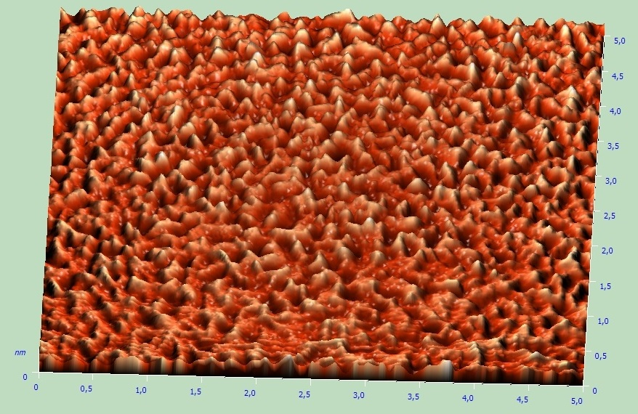
The results obtained
Thickness
Surface quality
Roughness
different
substrate-to-target
distance
Thickness, nm
Laser energy, mJ

Slide 8
Future investigations
Thermoelectric figure of merit measurements
Thermal & electric conductivity
Stoichiometry analysis
The design of test Peltier module
Mathematic and theoretical substantiation

Slide 9
Conclusions
The PLD method is suitable for Bi₂Te₃ film growth
High mechanical and functional properties
The regression analysis of film growth dynamics

Slide 10
Additional information
Grigor'yanc A.G., Misyurov A.I., Shupenev A.E., Surface analysis of Bi2Te3-based thin films obtained using pulsed laser deposition, Science and Education # 10, 2011.
Shupenev A.E., Mironov U. M., Russian Students Conference on Materials and Technology, Moscow, 2011
Grigor'yanc A.G., Misyurov A.I., Shupenev A.E., Submicron Bi2Te3 films generation peculiarities obtained by pulsed laser deposition, Vestnik MGTU, #6(6), 2012
Grigor'yanc A.G., Misyurov A.I., Shupenev A.E., Russian Students Conference on Materials and Technology, Moscow, 2012

